Slide 1


Examining human factor solutions with social and ethical implications to implement a web-based appointment and scheduling management information system (ASMIS).
The Human Factor module
Unit 6 Presentation
Notes:
This is a presentation for the human factor module Unit 6. Titled Examining Human Factor solutions with social and ethical implications to implement a web-based appointment and scheduling management information system.

Slide 2






Key priorities from the Unit 3 assignment
Social engineering
Pretexting
Phishing
Insider threat
Opportunities
Disgruntled employees
Human error
Accidental errors
Limited human capabilities
Ignorance
Usability challenges
Notes:
This presentation will look at the solutions for the human factor problems identified in the Unit 3 assignment. The three key priorities were social engineering, considering pretexting and phishing. The second priority was the insider threat which looked at opportunities or disgruntled employees. The third priority looked at human error, which could be accidental errors, identifying limited human capabilities, ignorance from staff or challenges with usability.

Slide 3



Scope of human factor solutions
Education and training
Usability in ASMIS software development
Organisational culture / workplace environment
Notes:
Therefore, to solve the problems identified, the thematic scope for this presentation will examine three solutions. These are education and training. Organisational culture and workplace environment. And finally, consider the usability in ASMIS software development.

Slide 4












Education and training
Solutions
Challenges
Simulations and game tools
Compliance increase (Alotaibi et al., 2016)
Artificial intelligence (Nebeker et al., 2019)
Improve skills and training (McIlwraith, 2021)
Blockchain technology to flag errors (Tahir et al., 2020)
COM-B model (Mayne, 2018) B-MAT Model (Fogg, 2009)
Gamification limited in formal context (Le Compte A. et al., 2015)
More vetting is needed on digital health technologies (Nebeker et al., 2019)
ENISA report - training not essential (ENISA, 2018)
Behaviours are difficult to change (Zhang-Kennedy et al., 2014)
Notes:
First, we will look at education and training. A solution to social engineering would be to incorporate game tools or simulations to engage users, understand security practices and provide human behaviour patterns. However, this is challenged by Compt et al. (2015) that they are limited to informal contexts because they do not offer a skills-based approach and do not give any information about how humans are influenced in their behaviour patterns. There is a place for simulations or game tools as one of the critical problems of users is non-compliance. Therefore, if there is a targeted approach, compliance could increase by using these methods. (Alotaibi et al. 2016).
To mitigate against the insider threat, Nebeker et al. (2019) suggested the use of artificial intelligence to take the responsibility away from humans to manage healthcare so that the insider threat is minimised and reduced opportunity. However, this is an emerging technology, and more vetting is needed in this area (Nebecker et al., 2019), and we will discuss these ethics later in the presentation.
Education and training can also support human error problems. McIlwraith (2021) also endorses that adequate training skill levels will improve users and help them make better-informed decisions on their behaviour. Emerging technologies such as blockchain could be used to identify and flag errors made by humans, which would help with efficiency (Tahir et al., 2020).
Mayne (2018) suggests using the COM-B model which focuses on capability, opportunity and motivation to define the user's behaviour. This can highlight the problem of human behaviour such as skills training, access level or trust?
We could also consider the B=MAT model from (Fogg 2009) to increase the likelihood of a behaviour to identify triggers for a particular behaviour pattern.
However the ENISA report (ENISA 2018) suggests that training is not essential, and actually, the workplace environment is more significant to instil a security culture. Also, behaviours are challenging to change and must be changed over a long time (Zhang-Kennedy et al., 2014). This shows that the organisational culture is crucial in mitigating human error.

Slide 5
Organisational culture / workplace environment
Solutions
Challenges
Security culture evaluation allows for organisational readiness (Georgiadou et al., 2020)
Security is everyone’s responsibility
A bottom-up approach to security policy could be more inclusive (McIlwraith, 2021)
Hybrid approach to find security champions (Becker et al., 2017)
Improving the work environment
ENISA (ENISA, 2018) Framework - not in awareness and training but in supporting domains that strongly influence the work environment of the individuals.
Organisation transparency to errors or breaches
Top-down management can be more effective (Neumann et al., 2021)
Rewards or punishments in line with the company's security goals are only effective with suitable leadership styles (transactional leadership) (Guhr et al., 2019)
Notes:
Organisational culture and the workplace environment can become everyone's responsibility. If the medical centre's management evaluates the security culture initially, they can assess if they have organisational readiness (Georgiadou et al. 2020). This will lay the foundation of a security policy to work with and to see if it is customisable for the company to adapt and change. McIlwraith (2021) would suggest that a bottom-up approach to security policy could be helpful as it would be more inclusive to all users. Other approaches, such as Becker et al. (2017), would consider a hybrid approach allowing users to become security champions where they would be acknowledged and rewarded for their outstanding security practice behaviour. To have an authentic organisational culture, the medical centre should have transparency throughout the domains so that errors or breaches can be easily identified and managed respectfully.
This solution can be challenged by suggesting that a top-down management approach could be more effective (Neumann et al., 2021). A top-down management approach could be helpful, such as having a chief information security officer with information and communication directed one way. This can have its pitfalls as communication and collaboration become blurred, and the working relationship between all users in the organisation can be hampered by mistrust. Another challenge is that rewards or punishments are sometimes given as incentives to create a better workplace environment. Guhr et al. (2019) suggest that these are only effective when there's a suitable leadership style, such as a transactional one. Transactional leadership motivates users to fulfil their self-interests and users need to be empowered as part of the original security policy tobe intrinsically motivated

Slide 6
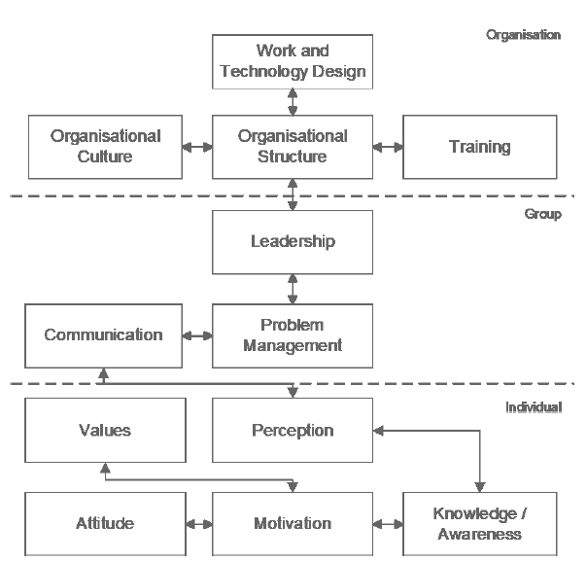
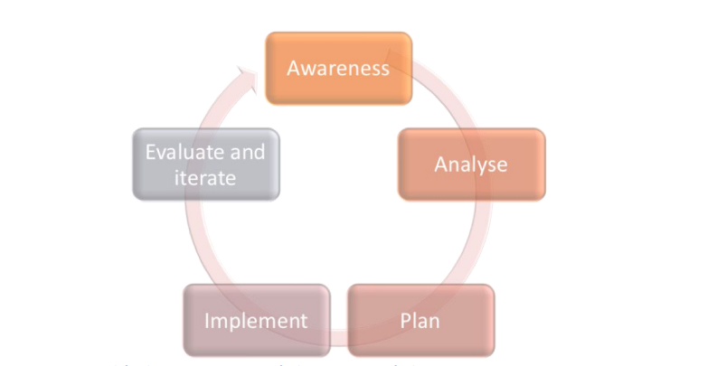
Figure 1: Framework for designing interventions for human aspects of cyber-security (ENISA, 2018)
Figure 2: Model of organisational behaviour (Schlienger, 2006)
Notes:
Figure 1 is a framework designed by ENISA which proposes an ongoing circular process to identify why vulnerabilities may happen and reviewinh past experiences that could mitigate potential human factor problems in the future.
This five-step process is helpful because it can be fully customised to the medical centre deciding a methodology for collecting data. Many organisations use self-reporting surveys, which may seem useful, yet users tend to leave out some crucial data that may implicate the user.
There has always been a tendency to use education and training to solve human factor problems. However, if we consider Schlienger's (2006) model of organisational behaviour, the dated study can also support and influence the work environment of the users. The model is helpful because the model identifies domains showing that all users have a responsibility. Users can develop their awarenes to make informed decisions on how they should behave. Rather than learn practises or be forced to have the training, some users might find it cognitively tricky to implement ideas and model will have a efficient practical outcome in real working scenarios. The framework is reflective so that all stakeholders can be involved in the continual process.

Slide 7
Usability in ASMIS development
Importance of resources and knowledge available. Experience in security incidents. Stakeholder pressure and company cultures affect the success (Assal and Chiasson, 2018)
Limited research in usability and user experience at present (Bitkina et al., 2020)
Secure by default (National Cyber Security Centre, 2018)
Solutions
Challenges
Incorporating stakeholders with developers in the design process
Agile frameworks and roadmaps (Rosenzweig, 2015)
Notes:
It would be essential to involve all stakeholders alongside the system's developers in the design process to give valuable input to their needs of the ASMIS system. Rosenzweig (2015) provides an insight into using agile frameworks and road maps.
The developers require resources available and the knowledge of expertise to be able to design the system securely and experience in security incidents (Assal and Chaisson, 2018). There is also limited research on usability and user experience at present (Bitkina et al. 2020), which suggests that as time goes on, more advances will be made in this area. The National Cyber Security Centre (2018) indicated that any developing system should be secure by default which does not make it necessarily user-friendly. Therefore, balancing the system's functionality, security and usability are challenging.
The developer team could consider focus groups to understand the stakeholders' use cases and consider peer reviews and testing the usability are helpful. Features such as the use of facial recognition in biometrics for patients entering the medical centre to process verification efficiently. To gauge a successful user experience, we must also consider the social and ethical implications.

Slide 8


Social and ethical considerations of developing and applying usable security
Solutions
Challenges
GDPR (Intersoft Consulting, N.D. )
User experience with disabilities (Hartson and Pyla, 2018)
Users needed for testing – Menlo report (Bailey et al., 2012)
Developers do not have enough formal ethics education in training (Nebeker et al., 2019)
Patients over-reliance on technology rather than seeing healthcare providers (Nebeker et al., 2019)
Notes:
Key points can be raised in developing and applying usable security. In some cases, developers do not always have enough formal ethics education in their training, and patients tend to over-rely on technology rather than see their healthcare practitioner (Nebeker et al., 2019). However, solutions are progressing, such as developers considering more accessible applications for patients with disabilities and designing keystroke features to support Parkinson's patients. The Menlo report (Bailey et al. 2012) suggested that users are needed for testing. But in doing so, certain rules need to be followed—respect for the participants involved and beneficence so that people are not harmed or come at a risk. There should be justice, so each participant deserves equal consideration on how to be treated whilst respecting the law and the public interest. There should be transparent methods and be accountable for any actions taken. Subjects for testing can also benefit from the GDPR Regulations to support any privacy concerns and the right to be forgotten from any future marketing or use of the testing data submitted.

Slide 9



Conclusion
Organisational culture and workplace environment
Support and transparency
Continuing professional development of staff
Inclusivity of stakeholders in the development process
Security culture vision adopted intrinsically
Image credits:
Portrait Of A Group Of Colleagues In Business Attire Smiling At Work by Flamingo Images from NounProject.com
Group Of Serious Colleagues Discussing Documents At Work by Flamingo Images from NounProject.com
Thermal Body Scanning Of Passengers Before Boarding Their Plane At The Airport by Jacob Lund Photography from NounProject.com
Notes:
To conclude, there is no simple strategic solution to solve all the human factor problems. However, the most effective solution would be to improve the organisational culture and workplace environment. However, this would need to be in conjunction with other solutions. A security culture would need to be an objective for all users that transpires support for colleagues. Developers need resources, education and continual professional development. Adding support should also consider security by design with a positive user experience for all stakeholders. It would be valuable for all stakeholders can be part of the security policy design for empowerment and valued input to the overall holistic vision.
Image credits:
Portrait Of A Group Of Colleagues In Business Attire Smiling At Work by Flamingo Images from NounProject.com
Group Of Serious Colleagues Discussing Documents At Work by Flamingo Images from NounProject.com
Thermal Body Scanning Of Passengers Before Boarding Their Plane At The Airport by Jacob Lund Photography from NounProject.com

Slide 10
References
Adams, M. & Makramalla, M. (2015). Cybersecurity skills training: An attacker-centric gamified approach. Technology Innovation Management Review, 5, (1).
Alotaibi, M., Furnell, S. & Clarke, N. Information security policies: A review of challenges and influencing factors. 2016 11th International Conference for Internet Technology and Secured Transactions (ICITST), 5-7 Dec. 2016 2016. 352-358.
Assal, H. & Chiasson, S. Security in the software development lifecycle. Fourteenth symposium on usable privacy and security (SOUPS 2018), 2018. 281-296.
Bailey, M., Dittrich, D., Kenneally, E. & Maughan, D. (2012). The Menlo Report. IEEE Security & Privacy, 10, (2): 71-75.
Becker, I., Parkin, S. & Sasse, M. A. (2017). Finding security champions in blends of organisational culture. Proc. USEC, 11.
Bitkina, O. V., Kim, H. K. & Park, J. (2020). Usability and user experience of medical devices: An overview of the current state, analysis methodologies, and future challenges. International Journal of Industrial Ergonomics, 76, 102932.
Enisa. (2018). Cybersecurity Culture Guidelines: Behavioural Aspects of Cybersecurity. Available from: https://securitydelta.nl/media/com_hsd/report/228/document/WP2018-O-3-3-2-Review-of-Behavioural-Sciences-Research-in-the-Field-of-Cybersecurity.pdf [Accessed 13 July 2022].
Fogg, B. (2019). Fogg behavior model. Behav. Des. Lab., Stanford Univ., Stanford, CA, USA, Tech. Rep.
Georgiadou, A., Mouzakitis, S., Bounas, K. & Askounis, D. (2020). A Cyber-Security Culture Framework for Assessing Organization Readiness. Journal of Computer Information Systems, 1-11.
Guhr, N., Lebek, B. & Breitner, M. H. (2019). The impact of leadership on employees' intended information security behaviour: An examination of the full‐range leadership theory. Information Systems Journal, 29, (2): 340-362.
Hartson, R. & Pyla, P. 2019. Chapter 15 - Mental Models and Conceptual Design. In: HARTSON, R. & PYLA, P. (eds.) The UX Book (Second Edition). Boston: Morgan Kaufmann.
Notes:
The final two slides are the references list.

Slide 11
References continued.
He, W., Ash, I., Anwar, M., Li, L., Yuan, X., Xu, L. & Tian, X. (2020). Improving employees’ intellectual capacity for cybersecurity through evidence-based malware training. Journal of Intellectual Capital, 21, (2): 203-213.
Intersoft Consulting. (N.D. ). GDPR. Available from: https://gdpr-info.eu/ [Accessed 22 January 2022].
Le Compte A., Elizondo D. & T., W. A renewed approach to serious games for cyber security. 2015 7th International Conference on Cyber Conflict: Architectures in Cyberspace, 26-29 May 2015 2015. 203-216.
National Cyber Security Centre. (2021). About Cyber Essentials. Available from: https://www.ncsc.gov.uk/cyberessentials/overview [Accessed 16 August 2021].
Nebeker, C., Torous, J. & Bartlett Ellis, R. (2019). Building the case for actionable ethics in digital health research supported by artificial intelligence. BMC Medicine, 17.
Neumann, W. P., Winkelhaus, S., Grosse, E. H. & Glock, C. H. (2021). Industry 4.0 and the human factor–A systems framework and analysis methodology for successful development. International journal of production economics, 233, 107992.
Mayne, J. (2018). The COM-B theory of change model. unpublished www. researchgate. net/publication/314086441_The_COM-B_Theory_of_Change_Model_V3 (accessed July 22, 2019).
McIlwraith, A. (2021). Information security and employee behaviour: how to reduce risk through employee education, training and awareness. Routledge.
Rosenzweig, E. (2015). Successful user experience: Strategies and roadmaps. Morgan Kaufmann.
Safa, N. S., Maple, C., Watson, T. & Von Solms, R. (2018). Motivation and opportunity based model to reduce information security insider threats in organisations. Journal of Information Security and Applications, 40, 247-257.
Schlienger, T. 2006. Informationssicherheitskultur in Theorie und Praxis - Analyse und Förderung sozio-kultureller Faktoren der Informationssicherheit in Organisationen.
Tahir, M., Habaebi, M. H., Dabbagh, M., Mughees, A., Ahad, A. & Ahmed, K. I. (2020). A Review on Application of Blockchain in 5G and Beyond Networks: Taxonomy, Field-Trials, Challenges and Opportunities. IEEE Access, 8, 115876-115904.
Zhang-Kennedy, L., Chiasson, S. & Biddle, R. (2014). Stop Clicking on “Update Later”: Persuading Users They Need Up-to-Date Antivirus Protection. 8462.
Notes:
Thank you for listening, and I hope you enjoyed the presentation.

